Slide 1
Convolutional Neuronal networks Theory part

Slide 2
1. CNN introduction
Content of the course:

Slide 3
2. CNN applications
Learning objectives of this chapter:
You know which general applications exist for CNNs
You can describe the project conditions of the truck project
You know what the DeepPiCar project is

Slide 4
2. CNN applications
Task:
Please name different CNN applications that are known to you.

Slide 5
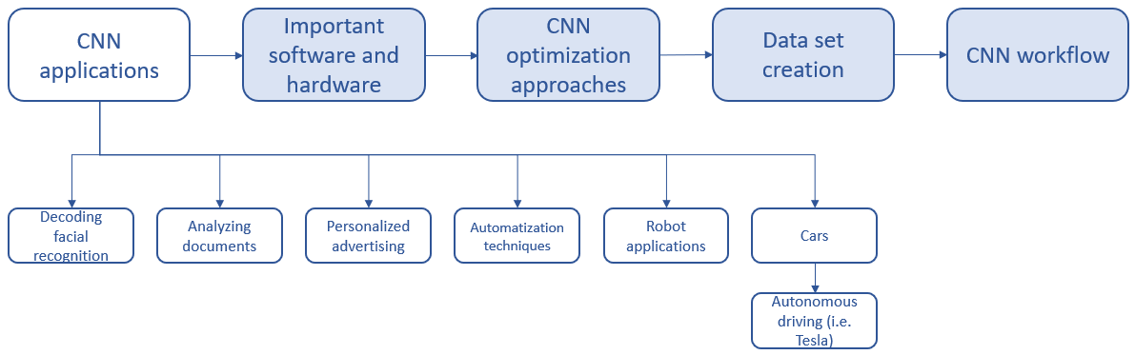
2. CNN applications
Different CNN applications:

Slide 6
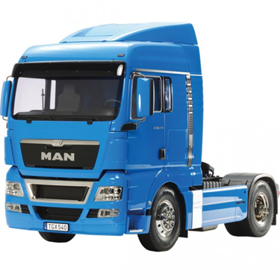
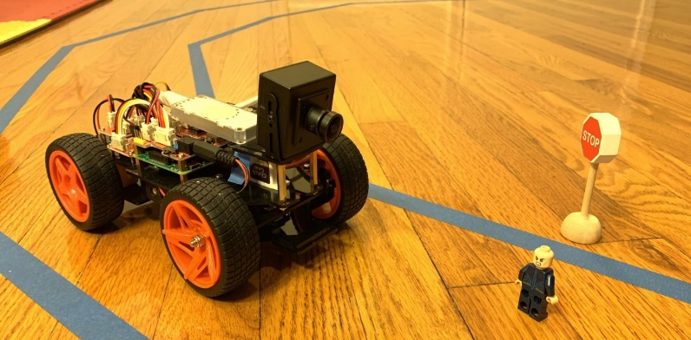
2. CNN applications
Project „CNN Truck“
Project „DeepPiCar“
[2]
[1]

Slide 7
3. Important hardware and software
Learning objectives of this chapter:
You know what the most important soft- and hardware’s for CNN projects are and can list them
Hardware:
You know what a GPU is and can describe how it works
You can roughly explain what a TPU is, and how it works
You know why in CNNs a TPU is more efficient than a GPU
Software:
You can explain what GitHub is and where it is used
You know the meanings of important GitHub commands
You can explain what Google Colab is

Slide 8
3. Important hardware and software
Task:
Please list different soft- and hardware that could be, in your opinion, important for the CNN truck project

Slide 9
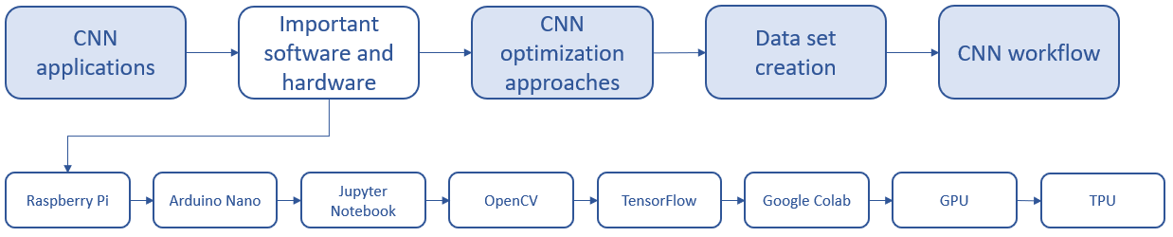
3. Important hardware and software
Overview

Slide 10
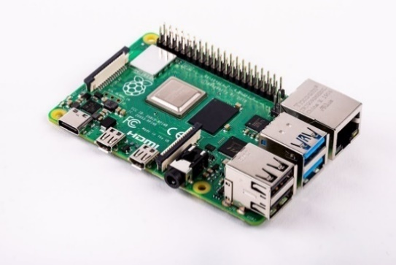
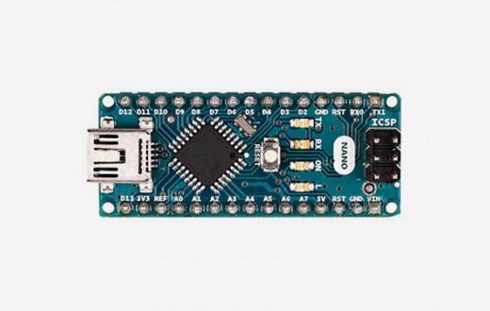
3. Important hardware and software
Raspberry Pi
Affordable small computer
Has two USB ports, an HDMI port, can connect to a monitor, keyboard, and mouse
Special USB Port for the webcam of the truck project
Arduino Nano
Small microcontroller
Information gets converted as binary code to the Arduino Nano (just „one direction transfer“ possible)
[3]
[4]

Slide 11




3. Important hardware and software
Jupyter Notebook
Open source application with possibilities to code, create visualizations, do machine learning, share created content
TensorFlow
Open source machine learning library
often used for image and video recognition and deep learning
Open CV
Open source software library Code
often used for image and video recognition and deep learning
Google Colab
cloud-based platform
machine learning with tensor flow possible
GPU and TPU can be used for free
[5]
[6]
[7]
[8]

Slide 12
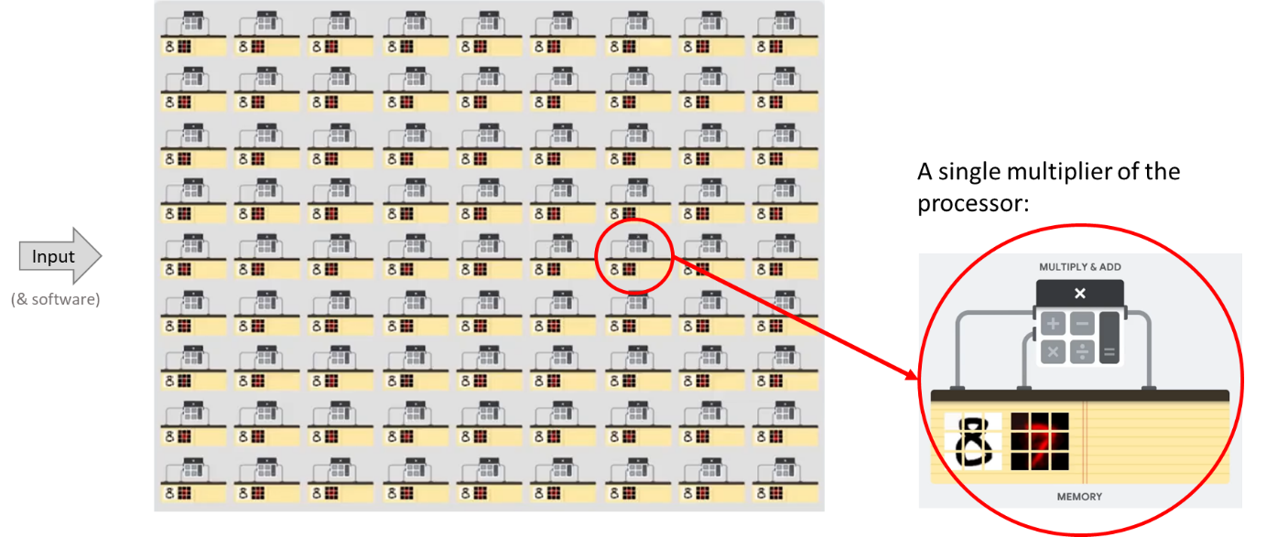
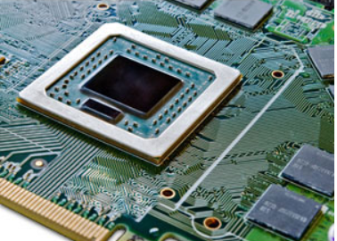
3. Important hardware and software
GPU - Graphical Processing Unit
specialized in processing graphics
wide range of applications
processor can do parallel tasks (matrix operations) very efficiently
after every single calculation intermediate result is read
[9]
[10]

Slide 13
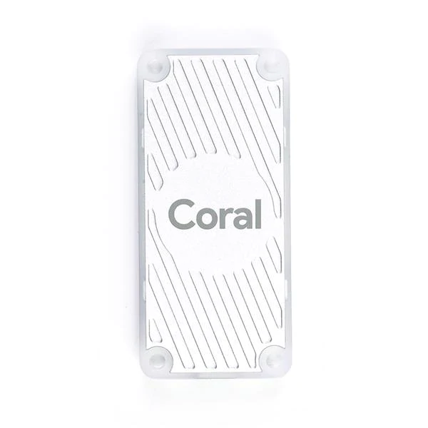
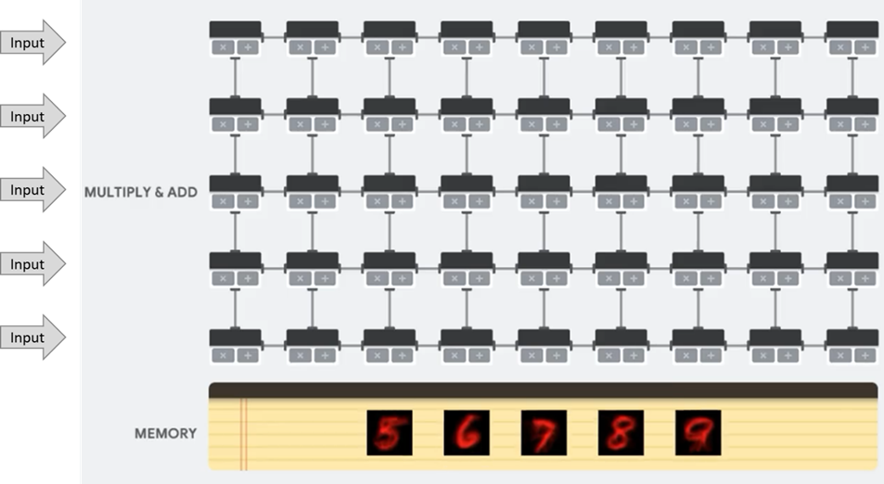
3. Important hardware and software
TPU - Tensor Processing Unit
specialized on machine learning with Colab and TensorFlow
special matrix processor
much faster than a GPU for machine learning
[11]
[10]

Slide 14

3. Important hardware and software
GitHub
GitHub is a platform where people can work together on the same project
You are able to find several project documentations including there codes
GitHub will be used as repository
The most important GitHub commands are shown in the flowing tables
[12]

Slide 15
3. Important hardware and software

Slide 16
4. CNN Optimization approaches
Learning objectives of this chapter:
You know general approaches for improving CNNs
You know and can explain optimization methods
You can explain the difference between HSV and RGB colour space and why the HSV colour space is preferred in the truck project

Slide 17
4. CNN Optimization approaches
Task:
Name possible solutions to optimize a CNN (besides transfer learning, deep learning).

Slide 18
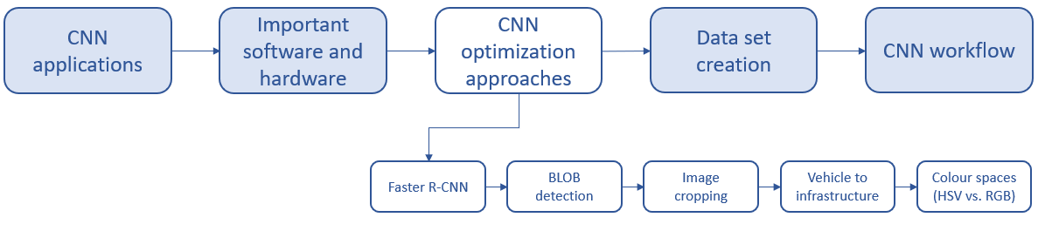
4. CNN Optimization approaches
Overview

Slide 19
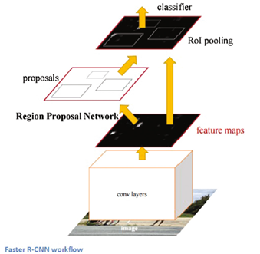
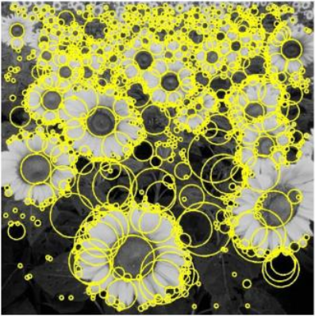
4. CNN Optimization approaches
Faster R-CNN
faster region-based CNN
uses Region Proposal Networks (RPN)
RPN is a neuronal network that splits the image into many different parts
BLOB detection
has multiple regions of interest and checks if there is a circular shape (in our case a traffic light)
if there are similarities in brightness a blob is generated
[14]
[13]

Slide 20
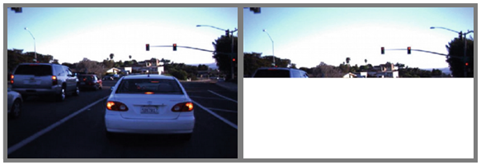
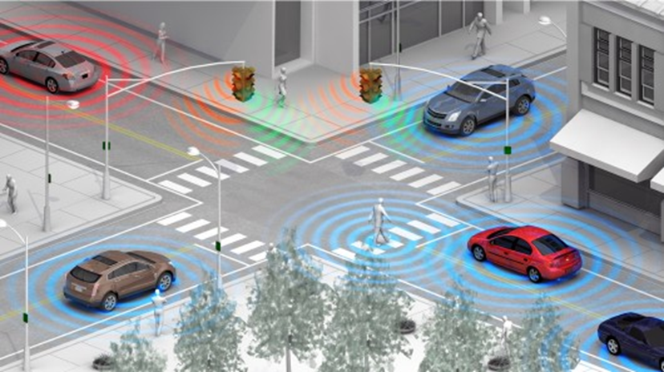
4. CNN Optimization approaches
Image cropping
remove the part of the picture that is not needed
the shrunk picture can be processed faster
Vehicle to infrastructure
the car communicates with the traffic light and other vehicles to ask for their status
the traffic light communicates its state to the car
the car reacts according to the transmitted information
[15]
[16]

Slide 21
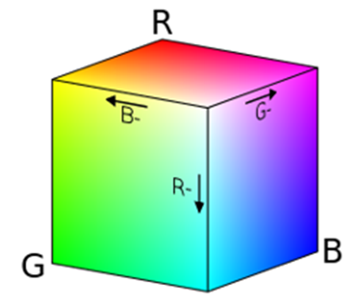
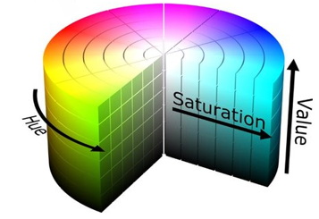

4. CNN Optimization approaches
RGB Colour Space
RGB ≙ Red, Green, Blue
each colour has a value between 0 and 255
if R,G, and B have a value of 255 the colour is white
RGB colour space is an additive colour space
HSV Colour Space
HSV ≙ Hue, Saturation, Value
Hue, Saturation, and Value are indicators for the used colour
H can take values between 0° and 360°
values for S and V are usually percentages
HSV colour space makes our traffic light system more invariant to illumination
[17]
[18]
[19]

Slide 22
5. Dataset creation
Learning objectives of this chapter:
You know the main steps to create a data set

Slide 23
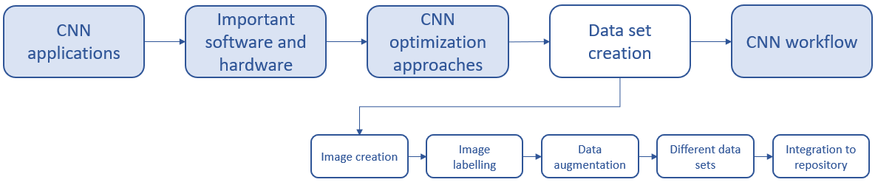
5. Dataset creation
Task:
What steps are necessary for data set creation?
Overview

Slide 24
5. Dataset creation
Process steps for data set creation:

Slide 25
6. CNN workflow
Learning objectives of this chapter:
You know a basic CNN workflow
You know how Transfer learning influences the workflow
You know how a TPU influences the workflow

Slide 26
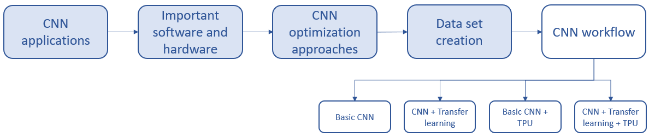
6. CNN workflow
Overview

Slide 27
6. CNN workflow
Task:
Please set up your own flowchart for a simple CNN. The flowchart should include the input and process steps which are necessary for creating a functional CNN. Please also consider the process of data set creation.

Slide 28
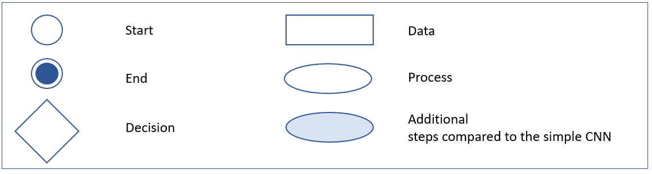
6. CNN workflow
Task of the CNN: CNN should detect the correct colour of a traffic light and sent it to the system
The flow diagrams show the different workflows of the different CNNs including all process steps
The legend below shows the single elements of the flow diagram

Slide 29
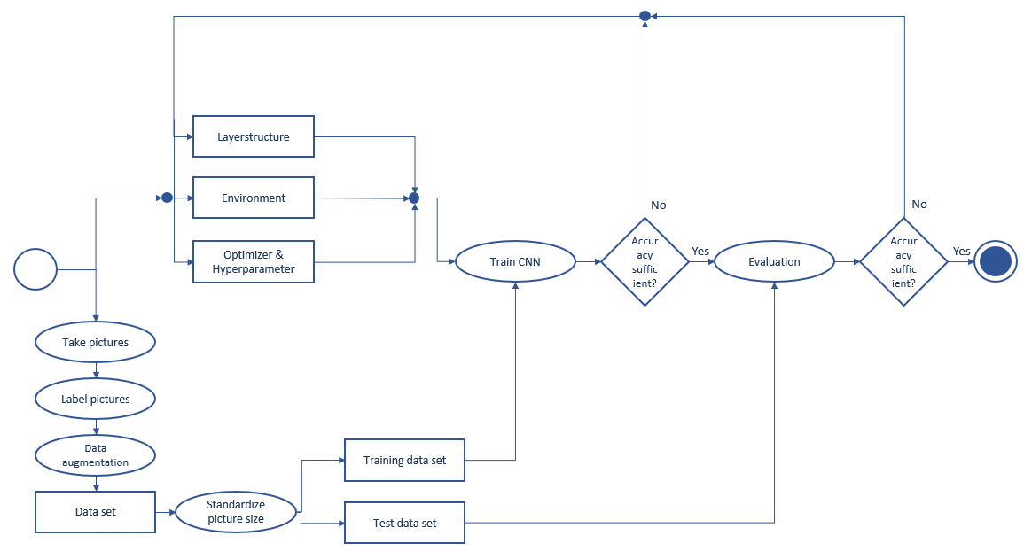
6. CNN workflow
1) Basic CNN

Slide 30
6. CNN workflow
1) Basic CNN workflow
Advantage: + relatively straightforward
Disadvantage: - accuracy of the network will be very low, especially at the beginning

Slide 31
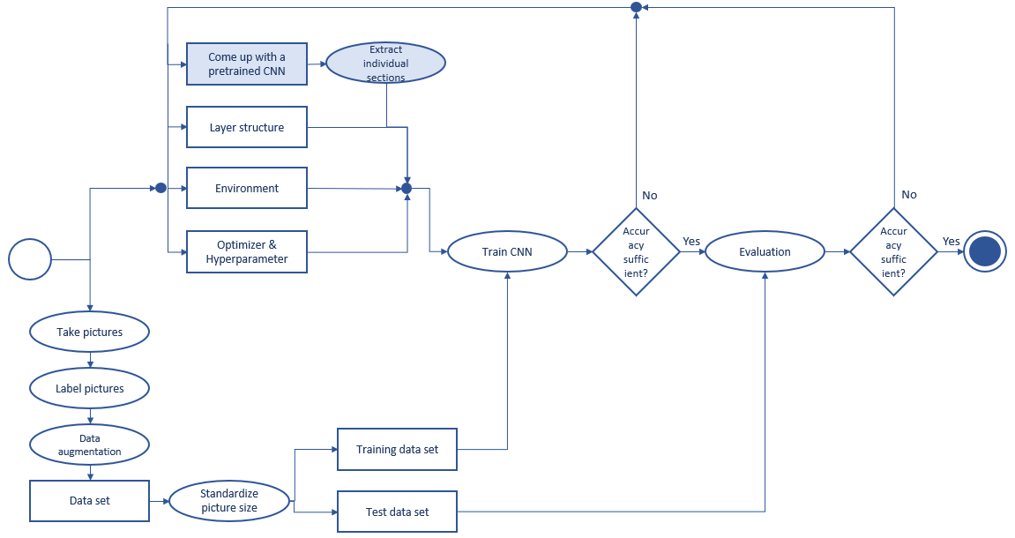
6. CNN workflow
2) CNN with transfer learning

Slide 32
6. CNN workflow
2) CNN workflow with Transfer Learning
Advantage: + higher accuracy
+ fast creation
Disadvantage: - an already trained system which fits well to the conditions of the truck project is not available yet
Note the boxes with a blue background that are new compared to the basic CNN workflow

Slide 33
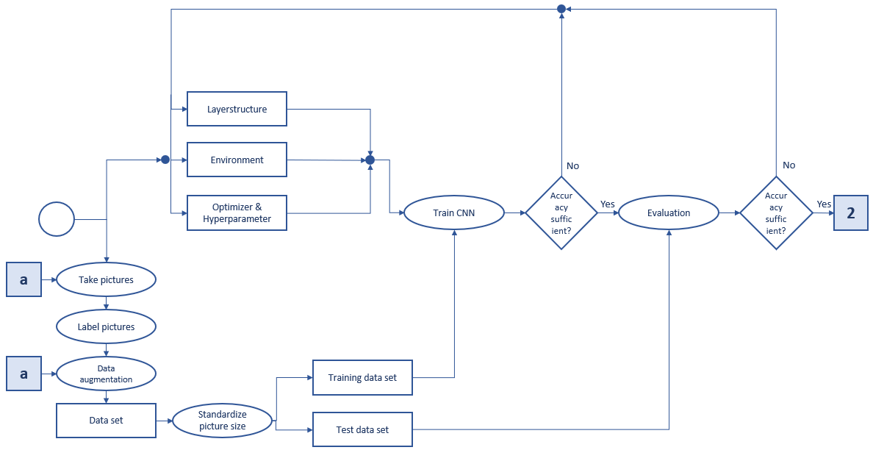
6. CNN workflow
3) CNN for TPU requirements

Slide 34
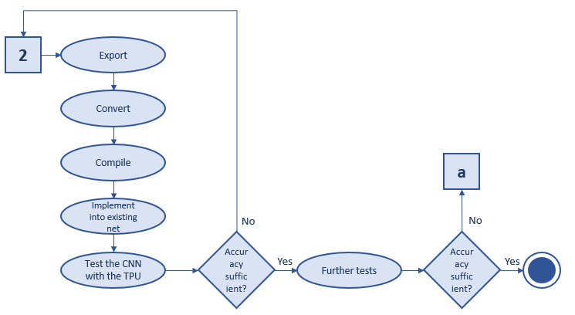
6. CNN workflow
3) CNN for TPU requirements

Slide 35
6. CNN workflow
3) Basic CNN workflow adjusted for the TPU
Advantage: + sufficient processing power
+ CNN can process faster
Disadvantage: - CNN structure is complex
Note the boxes with a blue background that are new compared to the basic CNN workflow

Slide 36
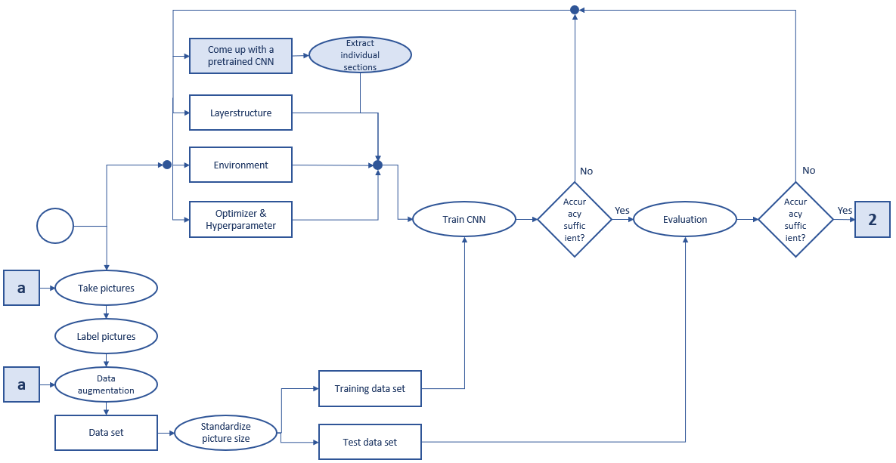
6. CNN workflow
4) CNN for TPU requirements with transfer learning

Slide 37
6. CNN workflow
4) CNN for TPU requirements with transfer learning

Slide 38
6. CNN workflow
4) Basic CNN workflow adjusted for the TPU
Advantage: + higher accuracy
+ fast creation
Disadvantage: - an already trained system which fits well to the conditions of the truck project is not available yet
Note the boxes with a blue background that are new compared to the basic CNN workflow

Slide 39
References
[1] MAN Truck, Picture of MAN Truck. [Online]. Available: https://​www.lindinger.at​/​at/​fahrzeuge-​und- ​boote/​modelle/​lkw-​und-​baufahrzeuge/​tamiya-​man-​tgx-​18.540-​blau-​lackiert-​1-​14
[2] D. Tian, DeepPiCar Series. [Online]. Available: https://​towardsdatascience.com​/​tagged/​deep-​pi-​car
[3] Raspberry Pi, What is a Raspberry Pi? [Online]. Available: https://​www.raspberrypi.org​/​help/​what-​%20is-​a-​raspberry-​pi/​
[4] A. Aqeel, Introduction to Arduino Nano. [Online]. Available: https://​www.theengineeringprojects.com​/​2018/​06/​introduction-​to-​arduino-​nano.html
[5] Jupyter, Jupyter Notebook (logo). [Online]. Available: https://​jupyter.org​/​
[6] OpenCV, Open CV (logo). [Online]. Available: https://​opencv.org​/​
[7] TensorFlow, TensorFlow (logo). [Online]. Available: https://​www.tensorflow.org​/​
[8] Google Colaboratory, Google Colaboratoy (logo). [Online]. Available: https://​colab.research.google.com​/​notebooks/​intro.ipynb
[9] H. Computer, Picture GPU. [Online]. Available: https://​www.computerhope.com​/​jargon/​g/​gpu.htm
[10] C. Google, Tensor Processing Unit. [Online]. Available: https://​storage.googleapis.com​/​nexttpu/​index.html
[11] R. Colab, Google Colaboratory. [Online]. Available: https://​colab.research.google.com​/​notebooks/​intro.ipynb
[12] GitHub, GitHub (logo). [Online]. Available: https://​github.com​/​

Slide 40
References
[13] S. Ren, K. He, R. Girshick, and J. Sun, “Faster R-CNN: Towards Real-Time Object Detection with Region Proposal Networks,” Jun. 2015. [Online]. Available:http://​arxiv.org​/​pdf/​1506.01497v3
[14] M. Kekoa, Blob Detection. [Online]. Available: https://​www.slideserve.com​/​maik/​blob- ​detection-​powerpoint-​ppt-​presentation
[15] G. Symeonidis, P. P. Groumpos, and E. Dermatas, “Traffic Light Detection and Recognition Using Image Processing and Convolution Neural Networks,” in vol. 1084, Creativity in Intelligent Technologies and Data Science, A. G. Kravets, P. P. Groumpos, M. Shcherbakov, and M. Kultsova, Eds., Cham: Springer International Publishing, 2019, pp. 181–190.
[16] Transportationops, Vehicle to infrastructure. [Online]. Available: https://​www.transportationops.org​/​V2I/​V2I-​overview
[17] Wikipedia, RGB colour cube. [Online]. Available: https://​de.m.wikipedia.org​/​wiki/​Datei:​RGB_​color_​cube.svg
[18] V. Popov, M. Ostarek, and C. Tenison, “Practices and pitfalls in inferring neural representations,” NeuroImage, vol. 174, pp. 340–351, 2018, doi: 10.1016/j.neuroimage.2018.03.041.
[19] Wikipedia, HSV Farbraum. [Online]. Available: https://​de.wikipedia.org​/​wiki/​HSV-​ Farbraum​#/media/Datei:HueScale.svg

